Slide 1
Multi Cycle Processor

Slide 2
Single Cycle Processor
Not utilized in modern designs
Inefficient
Clock cycle must have the same length for every instruction
Determined by the longest possible path in the machine
Several of the instructions could fit in a shorter clock cycle
Jump
R-Type
Load
Instr
Fetch
Instr decode
PC write
Instr
Fetch
Instr decode R read
ALU delay
Reg write
Instr
Fetch
Instr decode R read
ALU delay
Mem read
Reg write
Time wasted
Time wasted
Time wasted

Slide 3
Multi Cycle Processor
Jump
R-Type
Load
Instr
Fetch
Instr decode
PC write
Instr
Fetch
Instr decode R read
ALU delay
Reg write
Instr
Fetch
Instr decode R read
ALU delay
Mem read
Reg write
Clocks

Slide 4
Multi Cycle Approach
Break up the instructions into steps - GOAL
each step takes one clock cycle
balance the amount of work to be done in each step/cycle so that they are about equal
restrict each cycle to use at most once each major functional unit so that such units do not have to be replicated
functional units can be shared between different cycles within one instruction
Between steps/cycles
At the end of one cycle store data to be used in later cycles of the same instruction
need to introduce additional internal (programmer-invisible) registers for this purpose
Data to be used in later instructions are stored in programmer-visible state elements: the register file, PC, memory
Notes:
‹#›

Slide 5
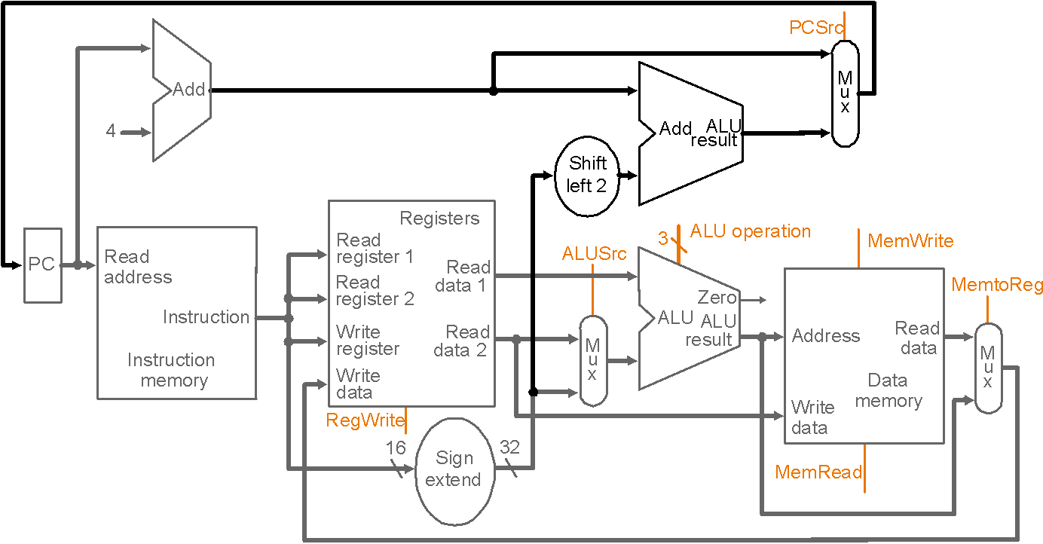
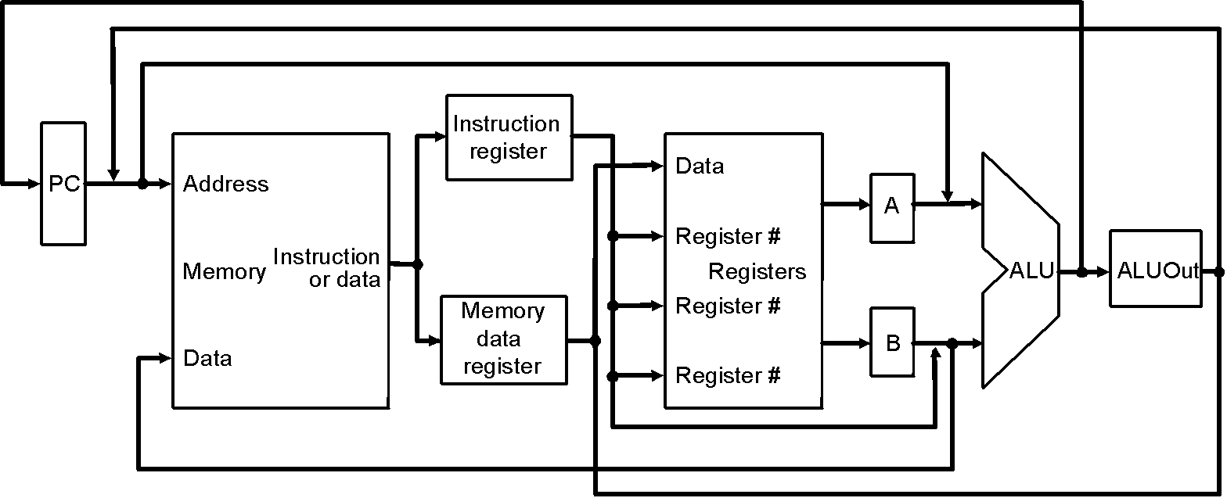
Multicycle Approach
Multicyle vs. single-cycle
diagrams
single memory for data
and instructions
single ALU, no extra adders
extra registers to
hold data between
clock cycles
Single-cycle datapath
Multicycle datapath (high-level view)
Notes:
‹#›

Slide 6
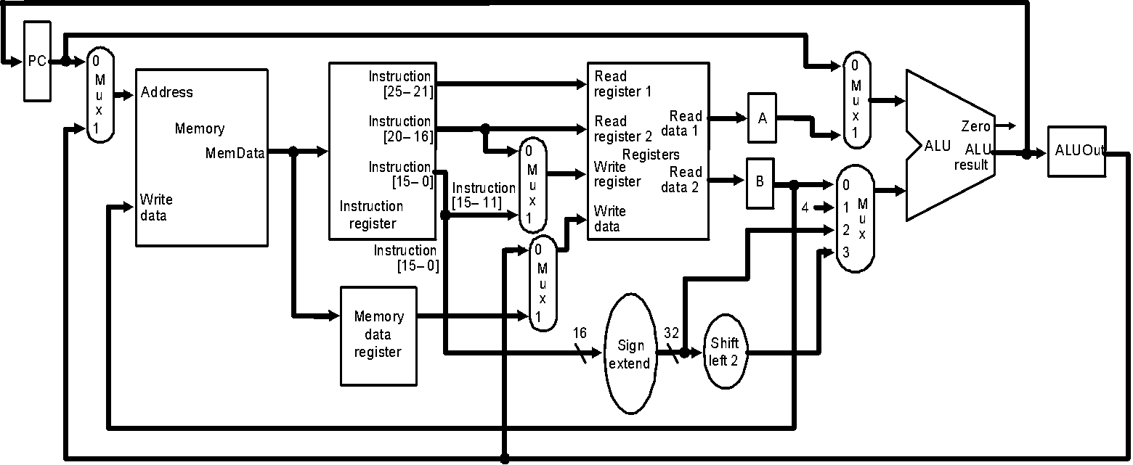
Multicycle Datapath
Basic multicycle MIPS datapath handles R-type instructions and load/stores:
new internal register in blue ovals, new multiplexors in green ovals

Slide 7
Breaking instructions into steps
Break instructions into the potential execution steps
– Not all instructions require all the steps
– Each step takes one clock cycle
Instruction fetch and PC increment (IF)
Instruction decode and register fetch (ID)
Execution, memory address computation, or branch completion (EX)
Memory access or R-type instruction completion (MEM)
Memory read completion (WB)
Each MIPS instruction takes from 3 – 5 cycles (steps)

Slide 8
Step 1: Instruction Fetch & PC Increment (IF)
Use PC to get instruction and put it in the instruction register.
Increment the PC by 4 and put the result back in the PC.
Micro operations using RTL (Register-Transfer Language):
IR = Memory[PC]; PC = PC + 4;
Notes:
‹#›

Slide 9
Step 2: Instruction Decode and Register Fetch (ID)
Read registers rs and rt if needed
Compute the branch address if the instruction is a branch
RTL: A = Reg[IR[25-21]]; B = Reg[IR[20-16]]; ALUOut = PC + (sign-extend(IR[15-0]) << 2);
Notes:
‹#›

Slide 10
Step 3: Execution, Address Computation or Branch Completion (EX)
ALU performs one of four functions depending on instruction type
Memory reference: ALUOut = A + sign-extend(IR[15-0]);
R-type: ALUOut = A op B;
Branch (instruction completes): if (A==B) PC = ALUOut;
Jump (instruction completes):
PC = PC[31-28] || (IR(25-0) << 2)
Notes:
‹#›

Slide 11
Step 4: Memory access or R-type Instruction Completion (MEM)
Again depending on instruction type:
Loads and stores access memory
Load
MDR = Memory[ALUOut];
Store (instruction completes)
Memory[ALUOut] = B;
R-type (instructions completes) Reg[IR[15-11]] = ALUOut;
Notes:
‹#›

Slide 12
Step 5: Memory Read Completion (WB)
Again depending on instruction type:
Load writes back (instruction completes)
Reg[IR[20-16]]= MDR;
Important: Need of this step:
There is no reason from a datapath (or control) point of view that Step 5 cannot be eliminated by performing
Reg[IR[20-16]]= Memory[ALUOut]; for loads in Step 4
This would eliminate the MDR as well.
The reason this is not done is that, to keep steps balanced in length, the design restriction is to allow each step to contain at most one ALU operation, or one register access, or one memory access
Notes:
‹#›

Slide 13
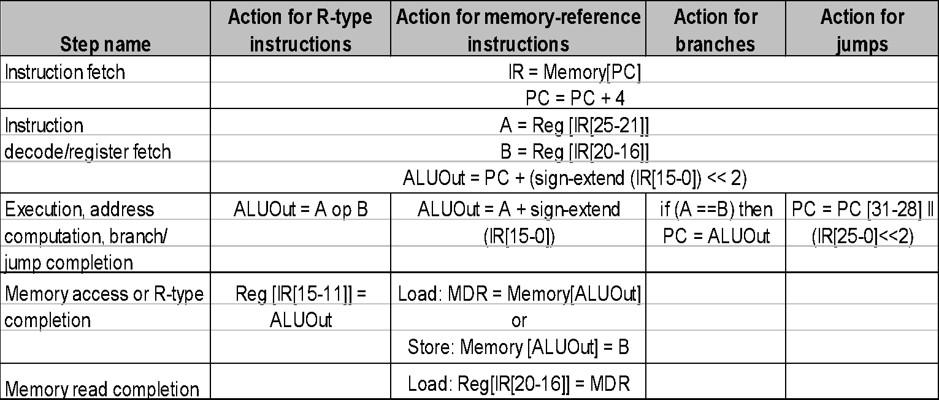
Summary of Instruction Execution
Step
1: IF
2: ID
3: EX
4: MEM
5: WB
Notes:
‹#›

Slide 14
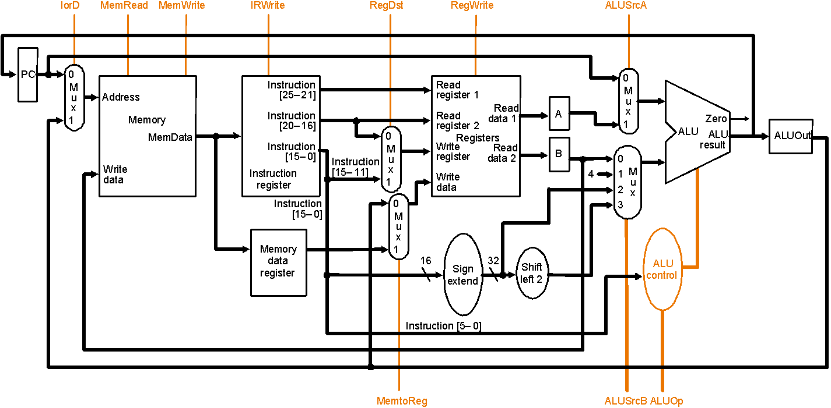
Multicycle Datapath with Control I
… with control lines and the ALU control block added – not all control lines are shown

Slide 15
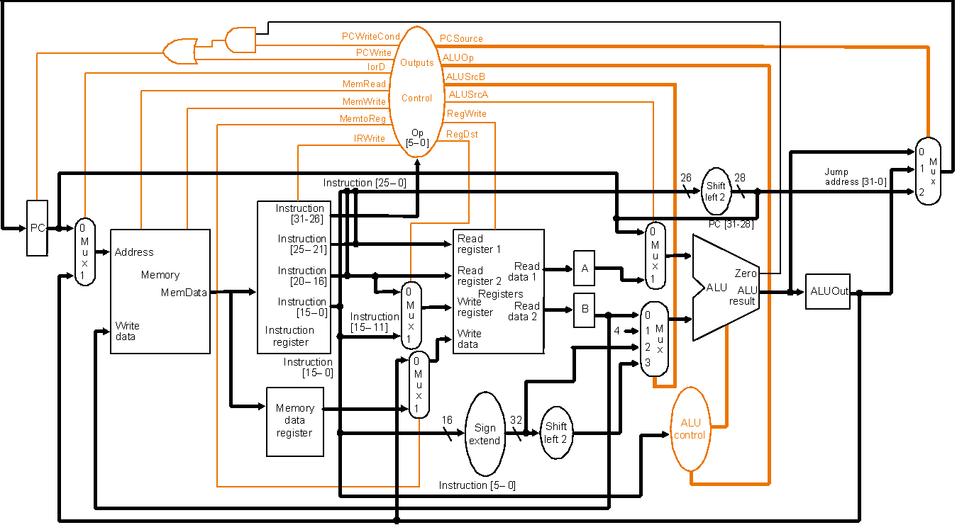
Multicycle Datapath with Control II
New gates
For the jump address
New multiplexor
Complete multicycle MIPS datapath (with branch and jump capability)
and showing the main control block and all control lines

Slide 16
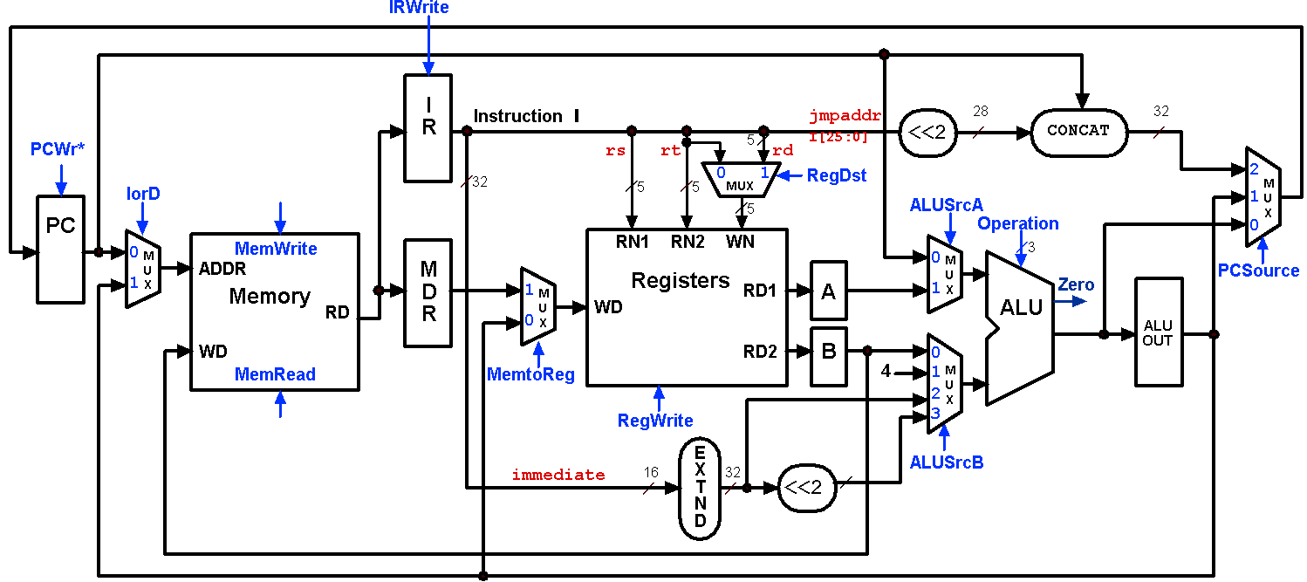
Multicycle Control Step (1): Fetch
IR = Memory[PC];
PC = PC + 4;
1
1
0
0
0
X
010
0
X
1
0
1

Slide 17
Multicycle Control Step (2): Instruction Decode & Register Fetch
A = Reg[IR[25-21]]; (A = Reg[rs])
B = Reg[IR[20-15]]; (B = Reg[rt])
ALUOut = (PC + sign-extend(IR[15-0]) << 2);
0
0
X
0
0
X
010
X
X
0
0
3

Slide 18
Multicycle Control Step (3): Memory Reference Instructions
ALUOut = A + sign-extend(IR[15-0]);
0
0
X
1
0
X
010
X
X
0
0
2

Slide 19
Multicycle Control Step (3): ALU Instruction (R-Type)
ALUOut = A op B;
0
0
X
1
0
X
???
X
X
0
0
0

Slide 20
Multicycle Control Step (3): Branch Instructions
if (A == B) PC = ALUOut;
0
1 if
Zero=1
X
1
0
X
011
1
X
0
0
0

Slide 21
Multicycle Execution Step (3): Jump Instruction
PC = PC[21-28] concat (IR[25-0] << 2);
0
1
X
X
0
X
XXX
2
X
0
0
X

Slide 22
Multicycle Control Step (4): Memory Access - Read (lw)
MDR = Memory[ALUOut];
0
0
1
X
0
X
XXX
X
X
1
0
X

Slide 23
Multicycle Execution Steps (4) Memory Access - Write (sw)
Memory[ALUOut] = B;
0
0
1
X
1
X
XXX
X
X
0
0
X

Slide 24
Multicycle Control Step (4): ALU Instruction (R-Type)
Reg[IR[15:11]] = ALUOut; (Reg[Rd] = ALUOut)
0
IRWrite
0
I
Instruction
I
jmpaddr
28
32
R
5
I[25:0]
<<2
CONCAT
PCWr*
X
rs
rt
rd
0
32
5
5
0
1
RegDst
X
2
M
IorD
MUX
1
XXX
1
5
ALUSrcA
U
PC
Operation
0
X
0
M
MemWrite
RN1
RN2
WN
0
3
U
ADDR
M
1
M
PCSource
1
X
D
Registers
A
U
Zero
Memory
0
M
WD
RD1
1
X
ALU
X
RD
R
0
U
1
X
ALU
WD
RD2
B
0
OUT
MemRead
MemtoReg
4
1
M
1
U
2
X
0
RegWrite
3
1
E
immediate
16
X
32
ALUSrcB
T
<<2
X
N
D

Slide 25
Multicycle Execution Steps (5) Memory Read Completion (lw)
Reg[IR[20-16]] = MDR;
IRWrite
0
0
I
Instruction
I
jmpaddr
28
32
R
5
I[25:0]
<<2
CONCAT
PCWr*
X
rs
rt
rd
X
0
32
0
1
RegDst
2
IorD
5
5
MUX
0
XXX
1
M
5
ALUSrcA
U
PC
Operation
0
X
0
M
MemWrite
RN1
RN2
WN
0
3
U
ADDR
M
Registers
M
PCSource
1
X
D
A
U
Zero
X
Memory
0
M
WD
RD1
1
X
ALU
RD
R
1
U
X
ALU
WD
RD2
B
0
OUT
MemRead
MemtoReg
4
1
M
0
U
2
X
0
RegWrite
3
1
E
ALUSrcB
immediate
16
X
32
<<2
X
T
N
D

Slide 26
From Patterson Book
2nd Edition Copy – Refer from beginning to point 5.5(including)
Not to refer: 5.5 onwards…

